Slide 1

课时练习
期末复习三 模块七 第三章

Slide 2
一、词汇。
(A)根据语境、音标或所给单词的提示完成句子，每空一词。
1. Mary is not as clever as her sister, but she works ________ (hard) than her.
2. My parents _______ (like) the hamburger, because they think it’s unhealthy.
3. Guests use the ________ /'menjuː/ every time they eat at the restaurant.
harder
dislike
menu

Slide 3
一、词汇。
(A)根据语境、音标或所给单词的提示完成句子，每空一词。
4. There are enough _______ for the audience(观众) in our hall.
5. In China, people with higher ____________ /ˌedʒu'keɪʃn/ play an important part in the labor force(劳动力) market.
seats
education

Slide 4
一、词汇。
(B)用括号内所给单词的适当形式填空，每空一词。
1. The Romance of the Three Kingdoms is a great book. It’s worth _________ (read) again and again.
2. Typical(典型的) English ___________ (gentleman) always bring umbrellas with them.
3. ___________ (develop) good study skills is very important for students.
reading
gentlemen
Developing

Slide 5
一、词汇。
(B)用括号内所给单词的适当形式填空，每空一词。
4. Many old books are for ________ (sell) to the students in the library.
5. With full preparation, we held the celebration ___________ (success).
sale
successfully

Slide 6
二、 重点句型。
1. 让我们祝他们成功。
Let’s ________________________________.
2. 我可以电话订餐吗？
Could I ______________________________?
3. 第一届国际美食节进展得非常顺利， 付出的努力有了回报。
The first International Food Festival _____________, and ______________________________________.
wish them success
order a meal by phone
went very well the results were worth the effort

Slide 7
二、 重点句型。
4. 据说有一半学生吃早饭没有规律。
It’s ___________________________ don’t have ________________________________________.
5. 总之，我们不仅应该吃足够多好的、健康的食物， 而且还要吃得有规律。
_________________, we should _________________
____________________________________________.
said that half of the students
breakfast regularly
In short/In a word not only eat enough good, healthy food but also eat regularly

Slide 8
三、重点语法。
★副词的比较级和最高级
(A)根据所学知识，将横线上的内容补充完整。
1. 构成
副词的原级就是其本身。副词的比较级和最高级的构成， 同形容词的比较级和最高级的构成相似。
(1)一般单音节和部分双音节副词加-er构成 _______ 级， 加-est构成 _______ 级。如：fast—faster—fastest; late—later—latest; early—earlier—earliest
比较
最高

Slide 9
三、重点语法。
(2)多音节和部分双音节副词在原级前加 ______ 构成比较级，加 ______ 构成最高级。如： easily—more easily—most easily
(3)有些副词的比较级和最高级是不规则的。如：
well—_______—______; badly—_______—_______;
much—_______—_______;
far—________/________—________/________
more
most
better
best
worse
worst
more
most
farther
further
farthest
furthest

Slide 10
三、重点语法。
2. 用法
(1)两者比较时，可用 “副词的 _______ 级+than” 表示 “比……更……”。副词的比较级前可以用a little, much和even等表示程度的词修饰。如：Molly studies much harder than her brother.
(2)“副词的比较级+and+副词的比较级” 表示 “越来越……”。多音节和部分双音节副词表达此意时，要用 “more and more +副词的 _____ 级”。如： It is raining more and more heavily outside.
比较
原

Slide 11
三、重点语法。
(3)“the+比较级(+其他)，the+比较级(+其他)” 表示“越……，越……”。如：The more you practice, the better you will do.
(4)两者比较时，也可以用as … as …，意为 “和……一样……”，否定为not as/so … as …，意为“……不如……”；两个as之间需用原级。如：Tina speaks English as well as Betty.

Slide 12
三、重点语法。
(5)三者或三者以上比较时用最高级。副词最高级前可以加the，也可以省略。最高级的比较范围常用介词in、of等引导的短语来表示。如：Tina sings the nicest of all the girls.

Slide 13
三、重点语法。
(B)根据中文提示完成英语句子。 (每条横线不限词数。)
1. 他是三个司机当中开车最认真的。
He drives __________________ of the three drivers.
2. 我妈妈每天早上起床比我早多了。
My mother gets up ______________________ every morning.
(the) most carefully
much earlier than me/I

Slide 14
三、重点语法。
(B)根据中文提示完成英语句子。 (每条横线不限词数。)
3. 雪正下得越来越大。
It is ____________________________________________.
4. Cindy画得与Helen一样好。
Cindy draws ______________________________.
5. 你练习得越多，你就会学得越好。
__________ you practice, __________ you will learn.
snowing harder and harder/more and more heavily
as well as Helen
The more
the better

Slide 15
四、单项选择。
( )1. It _______ China many years to develop the Beidou Satellite Navigation System(北斗卫星导航系统).
A. took B. paid C. spent
A

Slide 16
四、单项选择。
( )2. —_______ will you send me the email?
—In twenty minutes.
A. How long B. How soon C. How often
B

Slide 17
四、单项选择。
( )3. Of us all, Jack cooked _______. He’s sure to be a great cook in the future.
A. most successful B. most successfully
C. more successfully
B

Slide 18
四、单项选择。
( )4. No country in the world does _______ than China in poverty alleviation(脱贫).
A. well B. better C. best
B

Slide 19
四、单项选择。
( )5. —There is _______ rice in the bag. Could you buy some for me?
—Sure.
A. little B. a little C. few
A

Slide 20
四、单项选择。
( )6. —Guess what! I’ll go on a seven-day visit to Yunnan next month.
—Wow! ________!
A. Help yourself B. Enjoy yourself
C. Wish you success
B

Slide 21
四、单项选择。
( )7. —Our math teacher works hard. He teaches us _______.
—Yes, but he doesn’t come today. He doesn’t feel _______.
A. good; well B. good; good C. well; well
C

Slide 22
四、单项选择。
( )8. —Jane, what do you think of umbrella-sharing?
—It is very convenient(方便的) and it can protect the environment. ________, we should welcome such service.
A. In the end B. In fact C. In short
C

Slide 23
四、单项选择。
( )9. —Who sang ________ among the students?
—Linda. She sang than the others.
A. well; much better B. better; best
C. best; much better
C

Slide 24
四、单项选择。
( )10. —What else do you need?
—_______. I’m full.
A. No, that’s all
B. No, some things more
C. Sure, that’s all
A

Slide 25
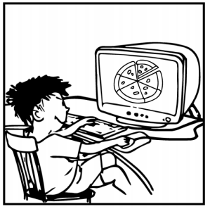
五、看图写话。
1. order, on
The boy ordered a pizza on the Internet./
He’s ordering a pizza on the computer.

Slide 26
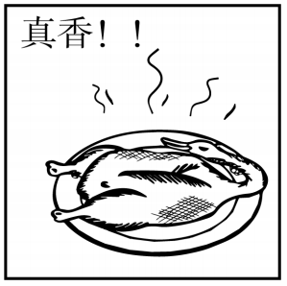
五、看图写话。
2. smell
The Beijing Roast Duck smells nice/good/delicious.

Slide 27
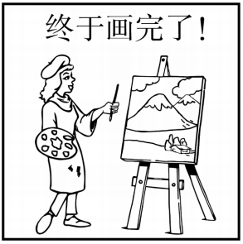
五、看图写话。
3. take, two hours
It took the girl/her two hours to finish (drawing) the picture.

Slide 28
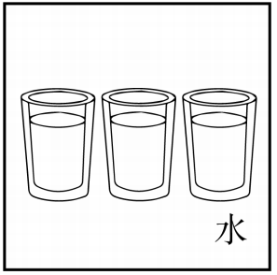
五、看图写话。
4. enough, health
Drinking enough water is good for people’s health.

Slide 29
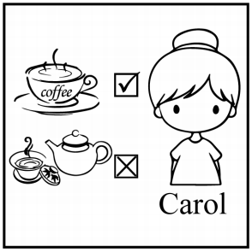
五、看图写话。
5. prefer
Carol prefers coffee to tea.

Slide 30
六、短文填空。
By keeping healthy daily habits, you can add years 1 your life. Here are some tips for living longer.
Take some exercise every day. Daily exercise improves our health. Studies show that daily exercise enables(使能够) us to live three years 2 (long). So, just catch every 3 /tʃæns/ to take exercise. Whenever we can, walk to work. If we live or work in a tall 4 (build), just take the stairs.
to
longer
chance
building

Slide 31
六、短文填空。
Eat a healthy breakfast. 5 (scientist) have told us something about breakfast. 6 we eat an early morning breakfast every day, we will be less likely(可能) to be too fat or get diseases. Breakfast eaters also agree that they feel great after breakfast. So eating breakfast is a healthy way to 7 ./stɑː(r)t/ our day.
Have 8 /ɪ'nʌf/ sleep. A lack(缺少) of sleep is bad for our body.
Scientists
If
start
enough

Slide 32
六、短文填空。
Failing to get at least seven hours of sleep appears to increase(增加) the risk of illness.
Find opportunities to communicate. There is 9 .old saying that a good friend is cheaper than treatment(治疗). Social communication can be good for our body and mind, because it makes us move around and helps refresh our mind with friends’ 10 .(suggest).
an
suggestions

Slide 33
七、阅读理解。
Researchers are warning(警告) that smokers are in danger of harming their eyes. 1 .
Smoking harms the lungs and hearts, but not many people know it also harms the eyes. Only one in five people think it is harmful to their eyes. So a group of doctors started an activity to tell people about the danger of smoking to the eyes. 2 The word “stub” means “putting out a cigarette by pushing the end against something”. 3 .

Slide 34
七、阅读理解。
4 Cigarette smoke gets in the eyes and causes different problems. The smoke has poisons(毒素) that can harm the eyes. It also has heavy metal(重金属). These can get into the eyes and lead to cataracts(白内障)—a problem that causes the eyes to become cloudy. 5 Smoke can also make sight(视力) problems worse for people with diabetes(糖尿病). So smokers should give up smoking.

Slide 35
七、阅读理解。
A. They called the activity “Stub It Out”.
B. The doctors explained(解释) why smoking harms the eyes.
C. So “stub it out” means “stop smoking”.
D. Smokers are more likely to lose their sight than non- smokers.
E. The doctors said smokers are also more likely to harm their eye muscles(肌肉).
1. _____ 2. _____ 3. _____ 4. _____ 5. _____
D A C B E

Slide 36


